Slide 1



Unconstrained distillation capacities of
a pure-loss bosonic broadcast channel
Masahiro Takeoka (NICT)
Kaushik P. Seshadreesan (MPL)
Mark M. Wilde (LSU)
arXiv:1601.05563
AQIS2016 at Academia Sinica, Taipei 29 August 2016

Slide 2
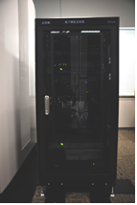
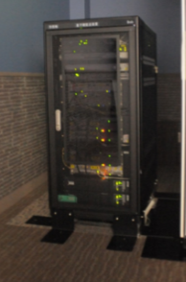
Introduction: QKD and Ent. distillation
- Quantum key distribution (QKD) and entanglement
distillation (ED) are two cornerstones of quantum
communication.
- Especially, QKD has been already deployed into field
operations and practical uses
Maintenance-free WDM QKD, Opt. Express 21, 31395 (2013).
A. Tajima et al., Thursday (Sep 1) morning @AQIS2016

Slide 3
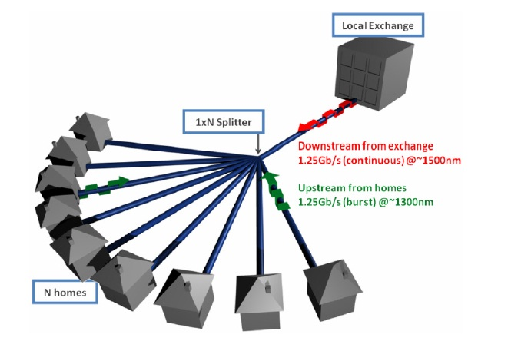
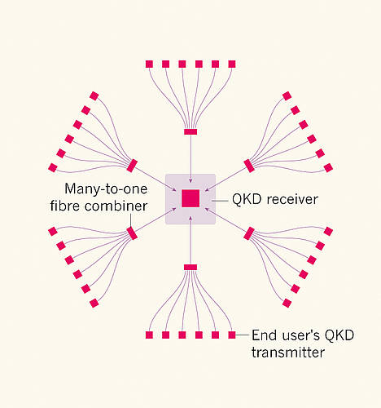
QKD over quantum network channels
1) A Quantum Broadcast Network.
2) A Quantum Multiple-Access Network.
3) More complicated
networks...
Townsend Nature 385, 47–49 (1997)
Bernd Frohlich et al.
Nature 501, 69–72 (2013)
sender
multiple
receivers
What is the fundamental limit of multi-user entanglement distillation and quantum key distribution in optical network channels?

Slide 4



Entanglement distillation and QKD:
LOCC-assisted quantum and private capacities
n-use of noisy quantum channel
Alice
Bob
k bits of entanglement
or secret key
k bits of entanglement
or secret key
Eve
Unlimited two-way classical communication
Secret key or entanglement generation rate:
LOCC-assisted quantum and private capacities
Supremum of all achievable

Slide 5



Pure-loss optical (bosonic) channel
- All the above experiments use optical (bosonic) channel.
- Simplest bosonic channel model: pure-loss channel
:channel transmittance
Alice
Bob
Eve
Beam splitter model of a pure-loss bosonic channel

Slide 6
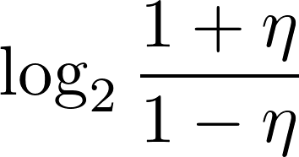

in a point-to-point pure-loss channel
- Squashed entanglement upper bound
- Single-letter upper bound for arbitrary quantum channels
Unconstrained (input power) upper bound
solely a function of channel loss
MT, Guha, Wilde, IEEE-IT 60, 4987 (2014), Nat Commun. 5:5253 (2014)

Slide 7
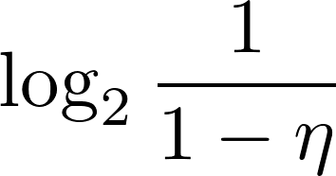

in a point-to-point pure-loss channel
- Squashed entanglement upper bound
- Single-letter upper bound for arbitrary quantum channels
Unconstrained (input power) upper bound
solely a function of channel loss
MT, Guha, Wilde, IEEE-IT 60, 4987 (2014), Nat Commun. 5:5253 (2014)
- Relative entropy of entanglement upper bound
- Improved upper bound for the pure-loss channel
-> matches with the coherent information based lower bound.
Capacity established for the pure-loss channel!
Pirandola, Laurenza, Ottaviani, Banchi, arXiv:1510.08863

Slide 8
in network channels
- C-Q capacity, unassisted quantum capacity of QBC, QMAC
Allahverdyan and Saakian, quant-ph/9805067.
Winter, IEEE Trans. Inf. Theory 47, 7, 3059 (2001).
Guha, Shapiro, Erkmen, Phy. Rev. A 76, 032303 (2007).
Yard, Hayden, Devetak, IEEE Trans. Inf. Theory 54, 3091 (2008).
Yard, Hayden, Devetak, IEEE Trans. Inf. Theory 57, 7147 (2011).
Dupuis, Hayden, Li, IEEE Trans. Inf. Theory 56, 2946 (2010).
- LOCC-assisted capacities (Q₂, P₂)
Seshadreesan, MT, Wilde, IEEE Trans. Inf. Theory 62, 2849 (2016)
- Single-letter upper bound for arbitrary quantum broadcast channel
based on multipartite squashed entanglement

Slide 9
in network channels
- C-Q capacity, unassisted quantum capacity of QBC, QMAC
Allahverdyan and Saakian, quant-ph/9805067.
Winter, IEEE Trans. Inf. Theory 47, 7, 3059 (2001).
Guha, Shapiro, Erkmen, Phy. Rev. A 76, 032303 (2007).
Yard, Hayden, Devetak, IEEE Trans. Inf. Theory 54, 3091 (2008).
Yard, Hayden, Devetak, IEEE Trans. Inf. Theory 57, 7147 (2011).
Dupuis, Hayden, Li, IEEE Trans. Inf. Theory 56, 2946 (2010).
- LOCC-assisted capacities (Q₂, P₂)
Seshadreesan, MT, Wilde, IEEE Trans. Inf. Theory 62, 2849 (2016)
- Single-letter upper bound for arbitrary quantum broadcast channel
based on multipartite squashed entanglement
This work: Q₂, P₂ on pure-loss bosonic broadcast channel

Slide 10












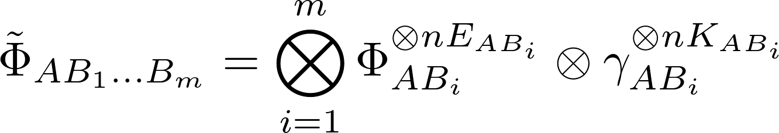


Main result
1-to-m pure-loss quantum broadcast channel (QBC)
pure-loss linear optical QBC
: power transmittance
from A’ to B_{i}
protocol
Protocol generating n-use of quantum channel and unlimited LOCC
: maximally entangled state
: private state

Slide 11
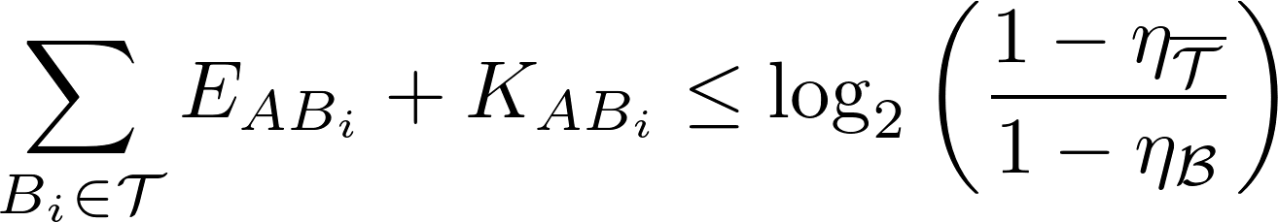


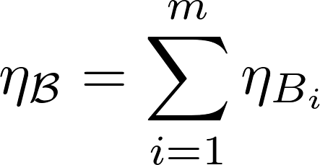
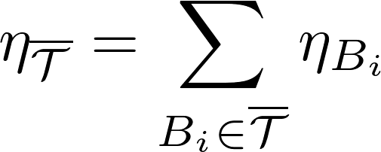
Main result
Theorem: The LOCC-assisted unconstrained capacity region of the pure-loss bosonic QBC is given by
for all non-empty , where ,
and .

Slide 12








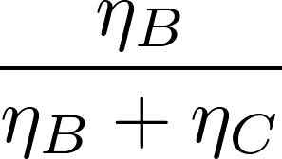


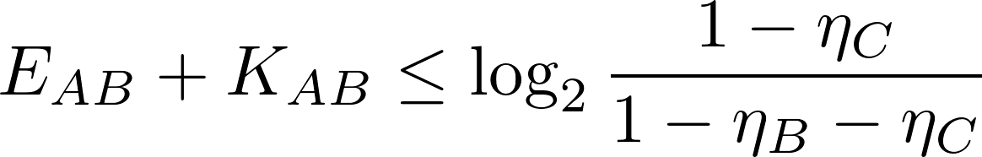
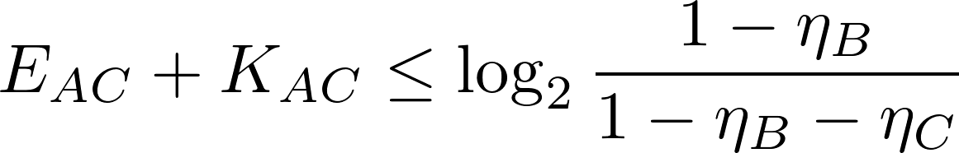
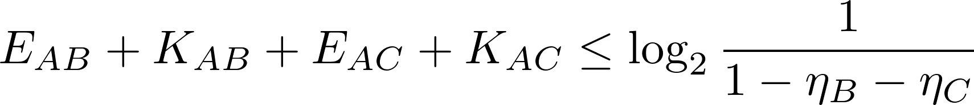
Example: 1-to-2 QBC
1-to-2 pure-loss quantum broadcast channel
A’
B
C
E
Capacity region

Slide 13
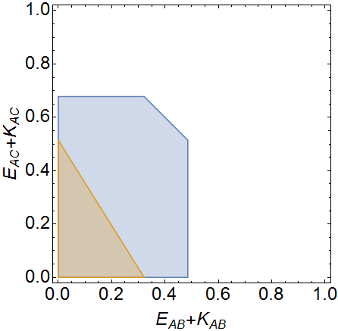

Example: 1-to-2 QBC
1-to-2 pure-loss quantum broadcast channel
A’
B
C
E
Capacity region
Timesharing bound

Slide 14
Proof outline
Achievability (1-to-2 QBC)
Converse (1-to-2 QBC)
Generalization to 1-to-m arbitrary linear optics network

Slide 15








Achievability
Horodecki, Oppenheim, Winter, Nature 436, 673 (2005), Commun. Math. Phys. 136, 107 (2007).
Tool: State merging
Protocol to merge a copy of distributed states via LOCC.
R
R
Alice
Bob
LOCC
Alice
Bob
Resource gain/consumption
If is positive
consuming bits of entanglement
If is negative
generating bits of entanglement
distilling entanglement
: conditional quantum entropy

Slide 16




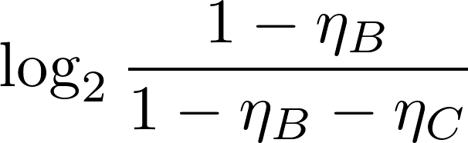

Achievability
- Send two-mode squeezed vacuum with average photon number N_{S}
from A to BC via n QBCs.
- State merging from BC to A.
Achievable rate region of entanglement distillation
Note: since 1 ebit of entanglement can generate 1 pbit of secret key, the lhs can be modified as etc.

Slide 17
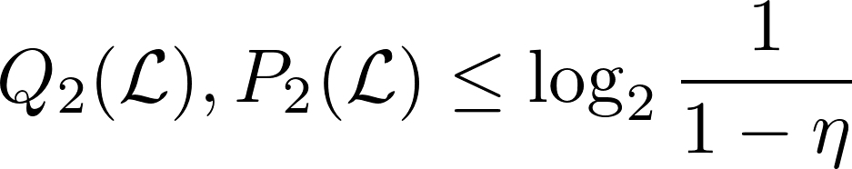
Converse
Main tool
- Point-to-point capacity for the pure-loss bosonic channel
(relative entropy of entanglement (REE) upper bound)
Pirandola, et al.,
arXiv:1510.08863
Step
1. Extension to a quantum broadcast channel
Seshadreesan, MT, Wilde, IEEE Trans. Inf. Theory 62, 2849 (2016)
2. Calculation of the REE
- Linear optics network reconfiguration (new observation)

Slide 18
Point-to-point channel (REE upper bound)
Pirandola, et al., arXiv:1510.08863

Slide 19
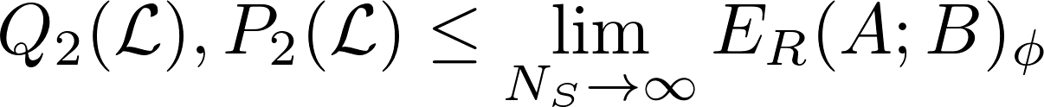

Point-to-point channel (REE upper bound)
Pirandola, et al., arXiv:1510.08863
1. Show
-Teleportation simulation technique
TMSV with average photon number N_{S}
Bennett et al., Phys. Rev. A 76, 722 (1996)
-Relative entropy of entanglement
Vedral and Plenio, Phys. Rev. A 57, 1619 (1998)

Slide 20
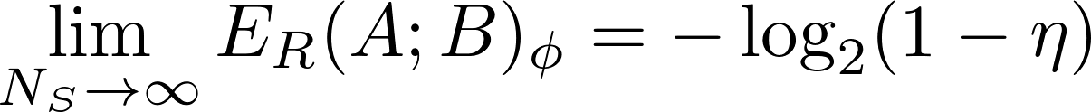
Point-to-point channel (REE upper bound)
Pirandola, et al., arXiv:1510.08863
1. Show
-Teleportation simulation technique
TMSV with average photon number N_{S}
Bennett et al., Phys. Rev. A 76, 722 (1996)
-Relative entropy of entanglement
Vedral and Plenio, Phys. Rev. A 57, 1619 (1998)
2. Calculation of the REE

Slide 21
Converse
Main tool
- Point-to-point capacity for the pure-loss bosonic channel
(relative entropy of entanglement (REE) upper bound)
Pirandola, et al.,
arXiv:1510.08863
Step
1. Extension to a quantum broadcast channel
Seshadreesan, MT, Wilde, IEEE Trans. Inf. Theory 62, 2849 (2016)
2. Calculation of the REE
- Linear optics network reconfiguration (new observation)

Slide 22



Converse
Step 1: REE bound for the QBC
Target state:
State generated by the protocol:
: maximally entangled state
: private state
Properties of REE
Partition the target state between B and AC,
- Monotonicity under LOCC
- Continuity
- Additivity on product states

Slide 23
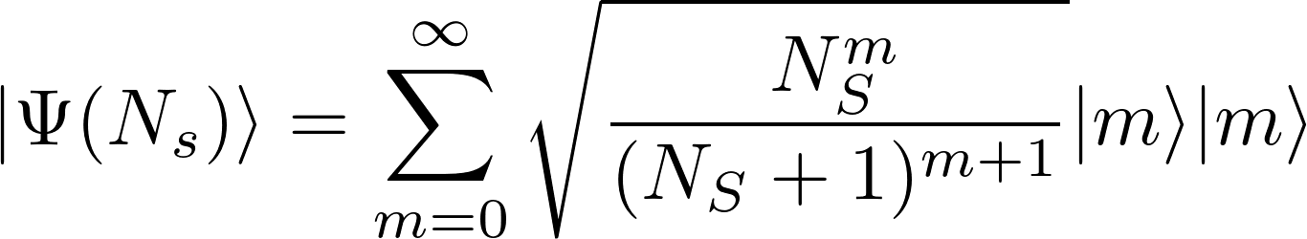
Converse
Step 1: REE bound for the QBC
Upper bound of the rate region

Slide 24
Converse
Step 2: Calculation of the REE
Key observation: reconfiguration of the linear optics network
(a)
(a): original pure-loss QBC
MT, Seshadreesan, Wilde, arXiv:1601.05563

Slide 25







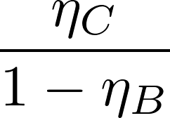

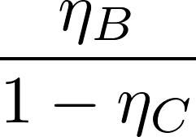
Converse
Step 2: Calculation of the REE
Key observation: reconfiguration of the linear optics network
(a)
(a): original pure-loss QBC
(b), (C): equivalent QBCs
(b)
(c)
MT, Seshadreesan, Wilde, arXiv:1601.05563

Slide 26

Converse
Step 2: Calculation of the REE
Bipartite case:
(b)

Slide 27
Converse
Step 2: Calculation of the REE
Bipartite case:
(b)
AB
C
pure-loss channel with

Slide 28
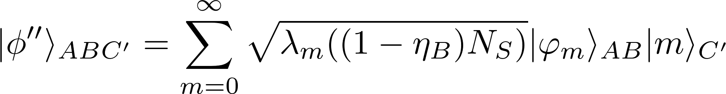
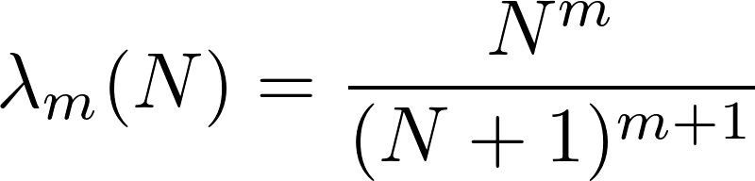
Converse
Step 2: Calculation of the REE
Bipartite case:
(b)
- State at ABC’ is a pure state.
- Observe the marginal state at C’ is
a thermal state.
- Thus the Schmidt decomposition
of the state in ABC’ is in the form
AB
C
pure-loss channel with

Slide 29

Converse
Step 2: Calculation of the REE
Bipartite case:
(b)
- State at ABC’ is a pure state.
- Observe the marginal state at C’ is
a thermal state.
- Thus the Schmidt decomposition
of the state in ABC’ is in the form
AB
C
pure-loss channel with
- Applying the local unitary operation

Slide 30



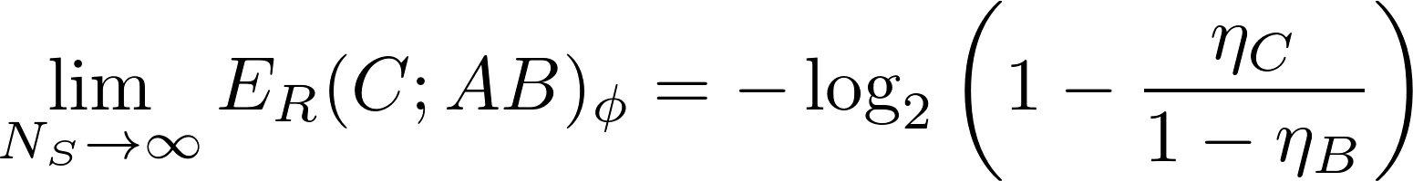
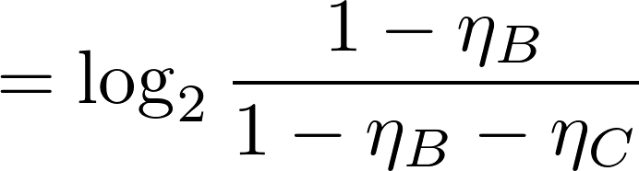
Converse
Step 2: Calculation of the REE
Bipartite case:
(b)
C
with
- As a consequence we have

Slide 31
Converse
Step 2: Calculation of the REE
Upper bound of the rate region

Slide 32
Proof outline
Achievability (1-to-2 QBC)
Converse (1-to-2 QBC)
Generalization to 1-to-m arbitrary linear optics network

Slide 33
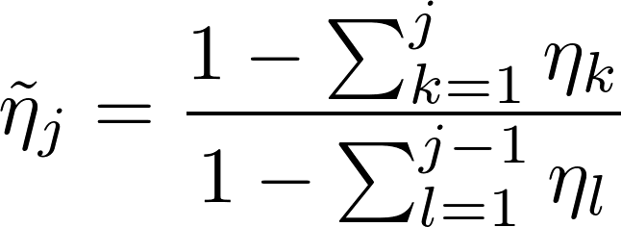




Generalization to 1-to-m QBC
1-to-2
1-to-m
sender
sender
m receivers
?

Slide 34

Generalization to 1-to-m QBC
Linear optical network decomposition
Reck, Zeilinger, Bernstein, Bertani, Phys. Rev. Lett. 73, 58 (1994)

Slide 35
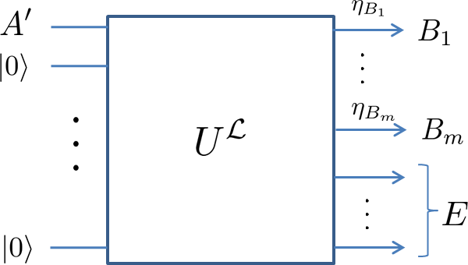
Generalization to 1-to-m QBC
Linear optical network decomposition
Reck, Zeilinger, Bernstein, Bertani, Phys. Rev. Lett. 73, 58 (1994)

Slide 36
Generalization to 1-to-m QBC
Linear optical network decomposition
Reck, Zeilinger, Bernstein, Bertani, Phys. Rev. Lett. 73, 58 (1994)

Slide 37
Generalization to 1-to-m QBC
1-to-2
1-to-m
sender
sender
m receivers

Slide 38

Conclusions
- The LOCC-assisted unconstrained capacity region of
the pure-loss bosonic quantum broadcast channel
for the protocol is established.
- Proof techniques
- state merging, teleportation simulation, relative entropy of entanglement,
QBC upper bounding, BS network reconfiguration
- Although our proof provides the weak converse, this can be strengthened to
the strong converse with the recent result by Wilde, Tomamichel, Berta,
arXiv:1602.08898.
arXiv:1601.05563
Open questions
- Entanglement and key distillation for
- Capacity region for other network channels (multiple-access, interference, etc.).
- Energy constrained capacity.

