Slide 1
Characterizing the Long-Term Behavior of a Quantum Ensemble
Speaker: Hao-Chung Cheng
Co-worker: Min-Hsiu Hsieh, Marco Tomamichel
Date: 01/20/2016

Slide 2
Outline
1
Introduction
1
Markov Semigroups
1
Case I: Parallel Evolution
1
Case II: Statistical Mixture
1
Comparisons
1
Discussions

Slide 3
Introduction
Quantum Markov Processes
Davies, Lindblad 60’s : open quantum systems
Quantum Dynamical Semigroup:
Long-term Behaviors:
Szehr, Reeb, Wolf (2012, 2013): fixed points, stability
Temme, et al. (2010): mixing time by the quantum $χ^{2}$-divergence
Kastoryano, Temme (2012): Exponential decays of -entropies
Applications
Kraus et al. (2008): State Preparation
Verstraete et al. (2009): dissipative quantum computations
G. Lindblad, “On the generators of Quantum dynamical semigroups,” Commun. Math. Phys. (1976)
F. Verstraete, M. Wolf, J. Cirac, “Quantum computation and quantum-state engineering driven by dissipation”, Nat. Phys. (2009)

Slide 4
Quantum Ensemble: C-Q Channel

Slide 5
MIMO Quantum Network
Black Box
Is there an equilibrium?
Convergence rate?

Slide 6
Structure of the Semigroup
Uncertainty measure
Matrix-valued function
Ensemble

Slide 7
Uncertainty Measure
R. Chen, J. Tropp, “Subadditivity of matrix entropy and concentration of random matrices,” Electron. J. Probab. (2014)

Slide 8
Properties

Slide 9
Axioms

Slide 10
Formalism

Slide 11
Matrix/Classical Markov Semigroups (1/2)

Slide 12
Matrix/Classical Markov Semigroups (2/2)

Slide 13
Sobolev Inequalities

Slide 14
Main Results: Exponential Decays

Slide 15
1
Introduction
1
Markov Semigroups
1
Case I: Parallel Evolution
1
Case II: Statistical Mixture
1
Comparisons
1
Discussions

Slide 16
Quantum Unital Channel

Slide 17
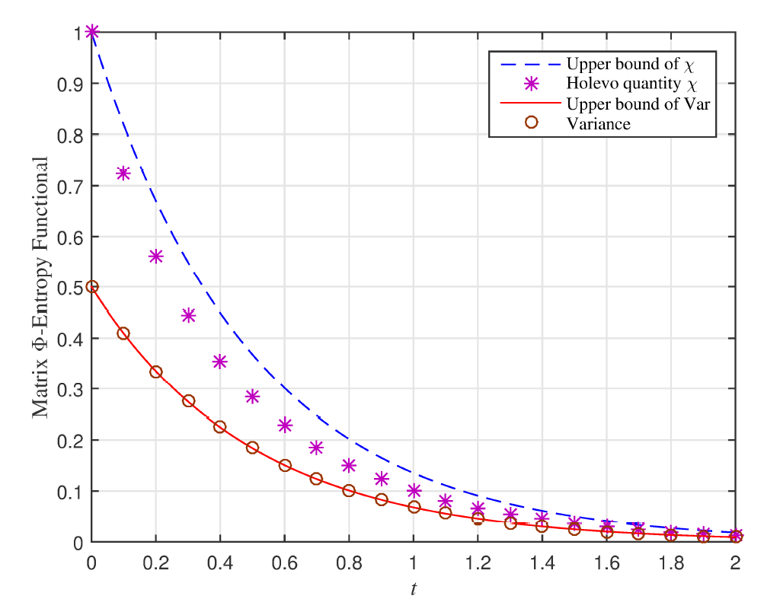
Depolarizing Channel

Slide 18
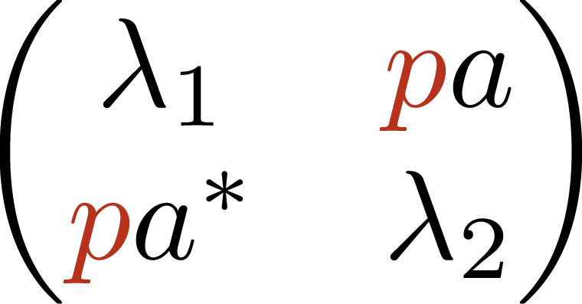
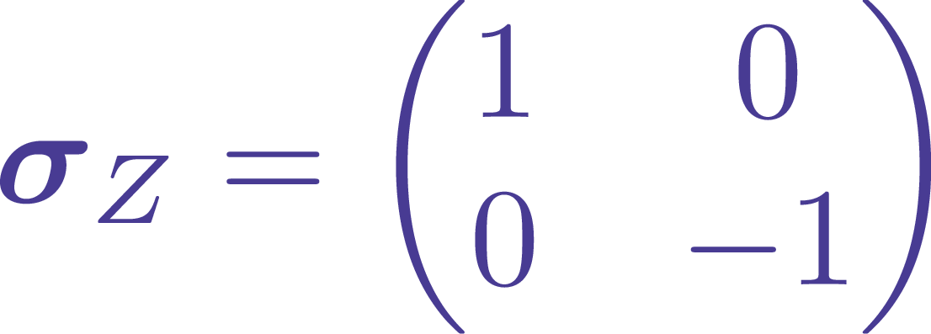
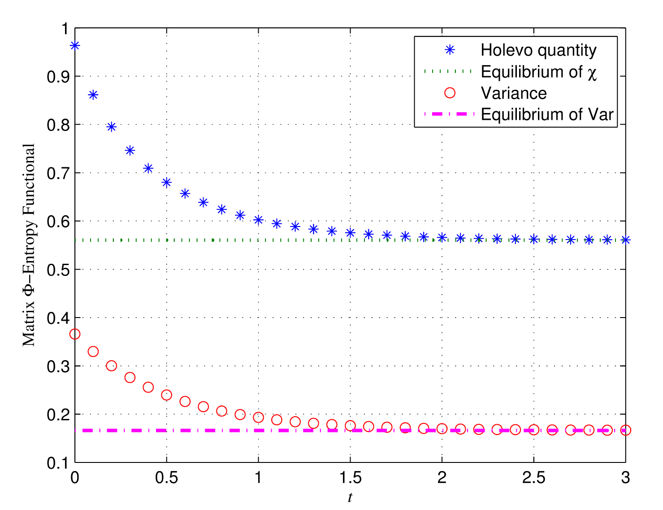
Phase-Damping Channel

Slide 19
1
Introduction
1
Markov Semigroups
1
Case I: Parallel Evolution
1
Case II: Statistical Mixture
1
Comparisons
1
Discussions

Slide 20
Jumping Process on Hypercubes (1/2)

Slide 21
Jumping Process on Hypercubes (2/2)
H.-C. Cheng, M.-H. Hsieh, arXiv: 1506.06801 [quant-ph]
R. Chen, J. Tropp, “Subadditivity of matrix entropy and concentration of random matrices,” Electron. J. Probab. (2014)

Slide 22
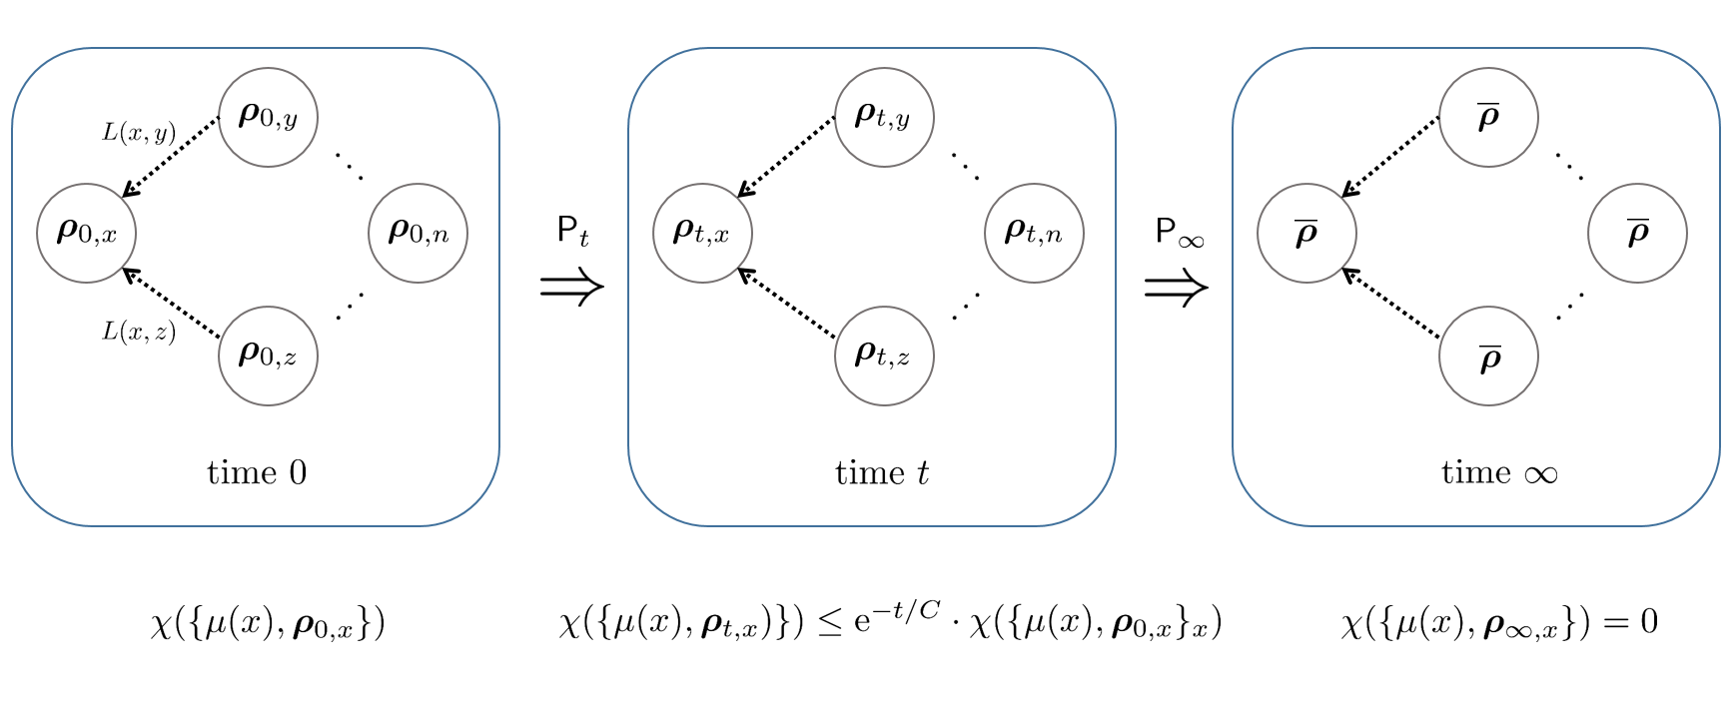
Statistical Mixing of a Quantum Graph

Slide 23
1
Introduction
1
Markov Semigroups
1
Case I: Parallel Evolution
1
Case II: Statistical Mixture
1
Comparisons
1
Discussions

Slide 24
Comparison ①: Invariant Measures

Slide 25
Comparison ②: Equilibrium

Slide 26
Comparison ③: The Parallel Evolution

Slide 27
Comparison ④: # of Fixed Points

Slide 28
Summary
A framework of Markov semigroups on quantum ensemble
Exponential entropy decay ↔ Φ-Sobolev inequalities
Sharp bound of the Holevo quantity
Questions:
Operational meaning of matrix Φ-entropies?
Application to physical systems

Slide 30
Relationship
Machine Learning
Concentration Inequalities
Physics
Entropy Method
Log-Sobolev Inequalities
Computer Science
Subadditivity
Markov Processes –
Semigroup Theory

